Slide 1

Case studies in networks
How information spreads through networks
David J.P. O’Sullivan
osullivan@maths.ox.ac.uk

Slide 2
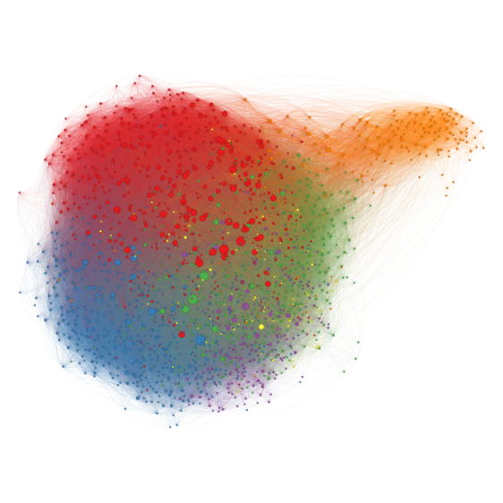

What were going to talk about
Case studies in network analysis
Going to go through some of my work
Use this as an excuse to introduce some ideas
Today network structure
Tomorrow cascades and customer churn
Notes:
Do normally talk a break?

Slide 3
What were going to talk about
GitHub
Code to recreate some of the analysis here
Data to have a play with
More on that later
Papers that I talk about
Links to books
Links tutorials in R
https://github.com/DavidJPOS/CaseStudiesInNetworks

Slide 4
What were going to talk about
The kind of things I'm interested in
Using network science and statistics to answer interesting questions and building tools for social science
How people self sort into groups (communities)
What this means for the spread of information on networks
Collective behaviour
Make makes people change their behaviour?
We’ll briefly talk on how network are used for this
(always coming back to the data)

Slide 5
A little break to play with R
Basics of R and the tidyverse
Interactive demo 1 & 2

Slide 6
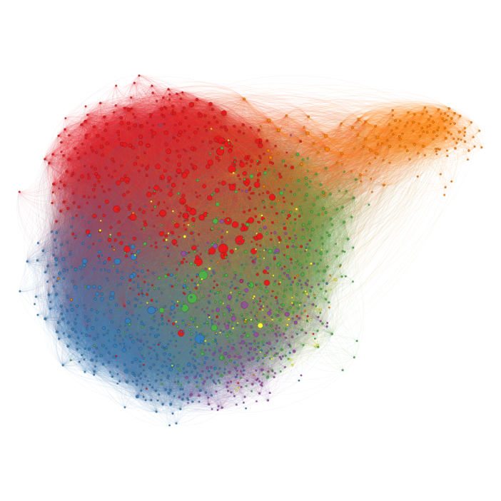
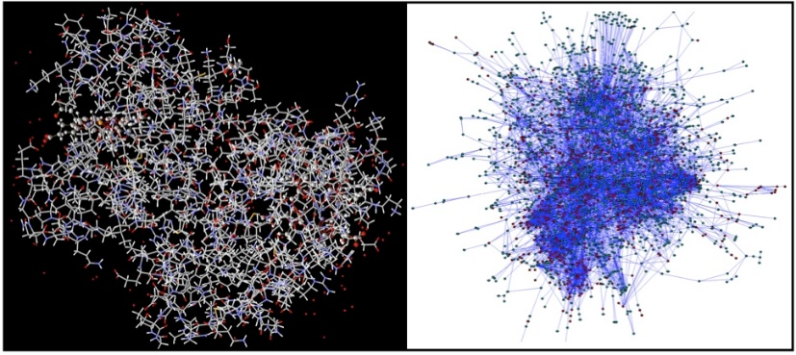
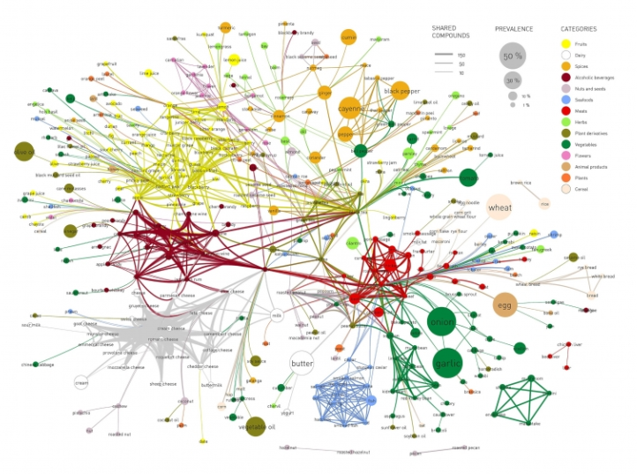
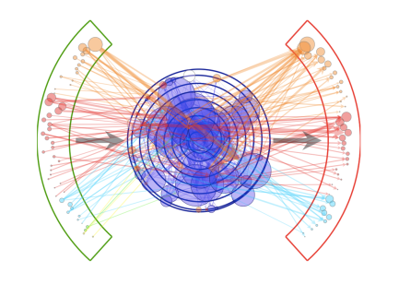
Basics of network theory
What is a network?
Social networks
Biological networks
Financial network

Slide 7
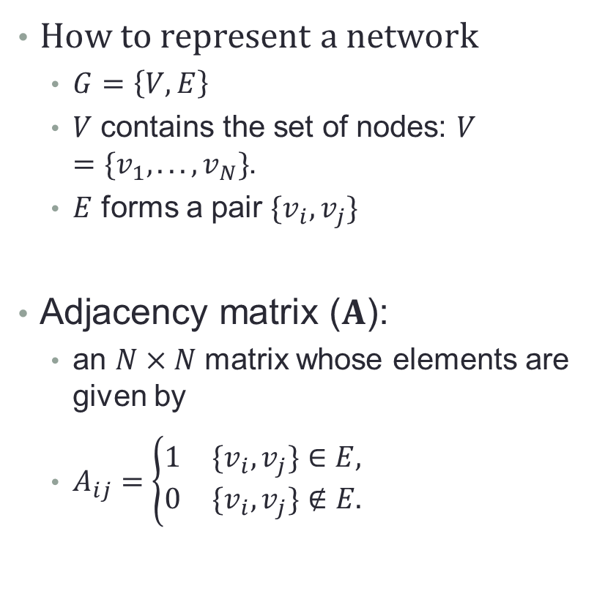
Basics of network theory
How to represent a network
$G=\left\{V,E\right\}$
$V$ contains the set of nodes: $V=\{v_{1},...,v_{N}\}$.
$E$ forms a pair $\{v_{i},v_{j}\}$
Adjacency matrix ($A$):
an $N×N$ matrix whose elements are given by
$A_{ij}=\left\{\begin{matrix}1 & \{v_{i},v_{j}\}∈E, \\ 0 & \{v_{i},v_{j}\}∉E.\end{matrix}\right.$

Slide 8
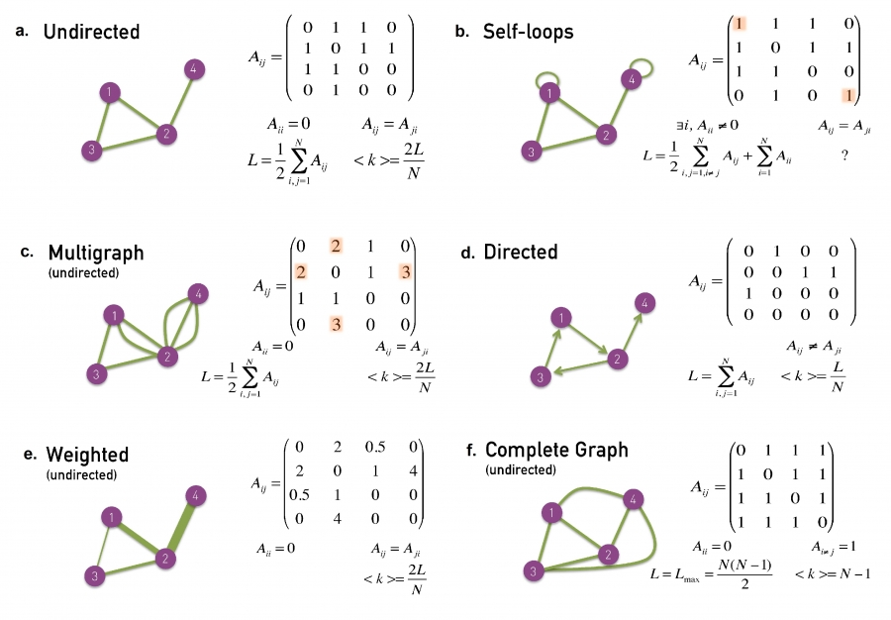
Basics of network theory

Slide 9
Basics of network theory

Slide 10
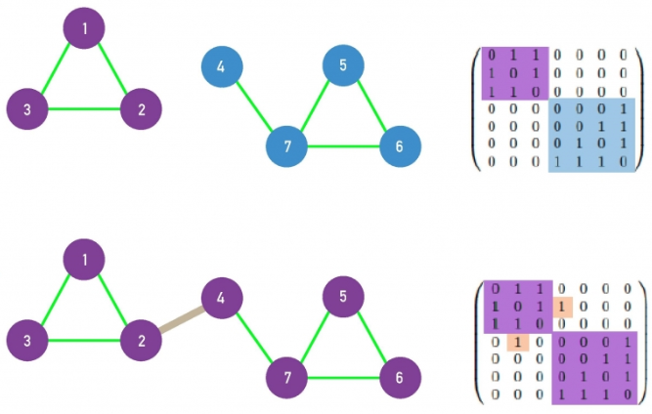
Basics of network theory
Connectedness
Is the graph fractured into smaller parts?
One big group?
Fully connected

Slide 11
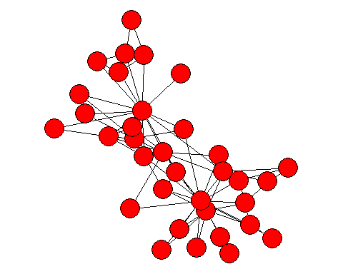
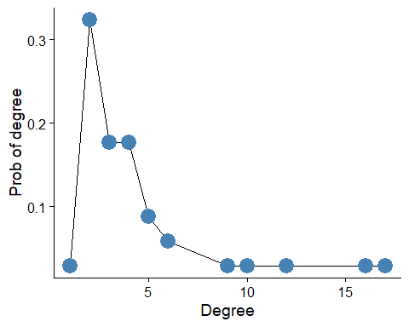
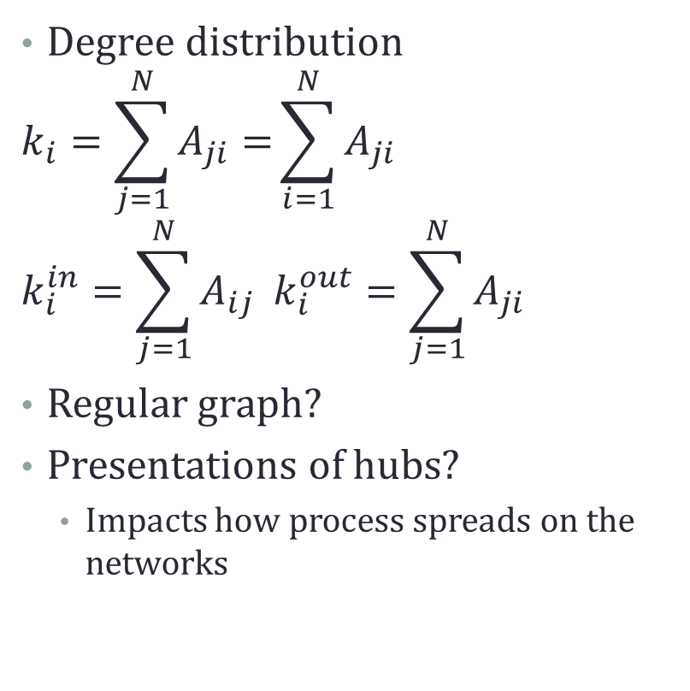
Basics of network theory
Degree distribution
$$k_{i}=\sum_{j=1}^{N}{A_{ji}=}\sum_{i=1}^{N}{A_{ji}}$$
$$k_{i}^{in}=\sum_{j=1}^{N}{A_{ij}} k_{i}^{out}=\sum_{j=1}^{N}{A_{ji}}$$
Regular graph?
Presentations of hubs?
Impacts how process spreads on the networks

Slide 12
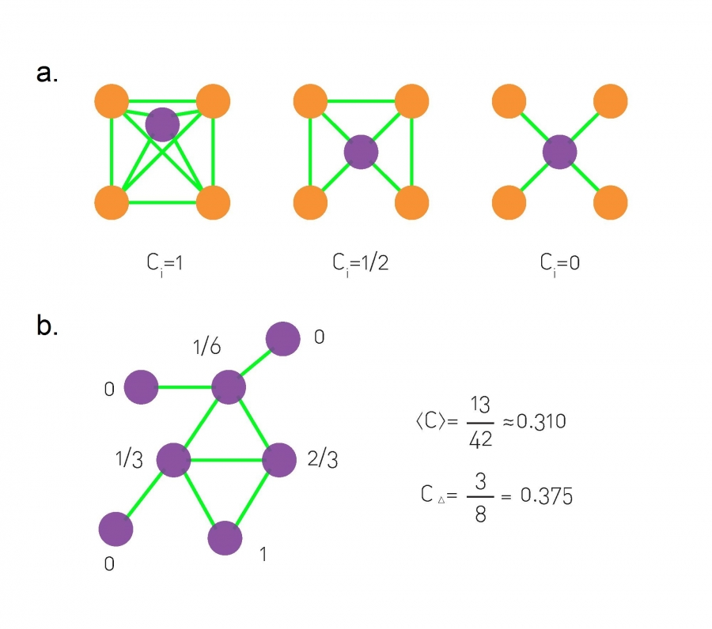
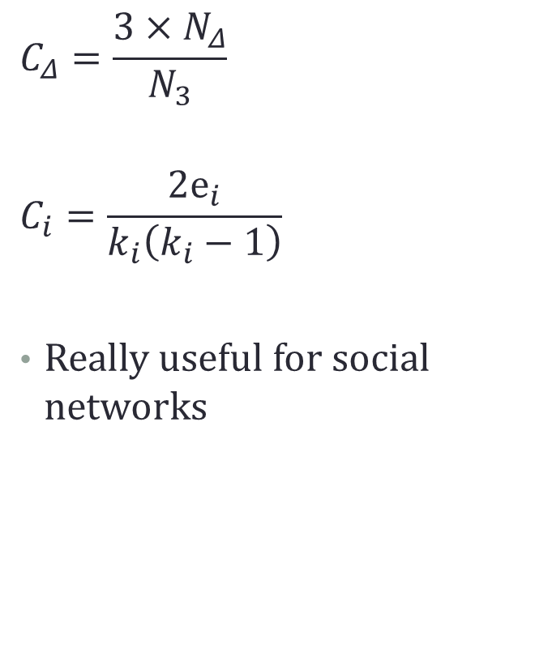
Basics of network theory
$$C_{Δ}=\frac{3×N_{Δ}}{N_{3}}$$
$$C_{i}=\frac{2e_{i}}{k_{i}\left(k_{i}−1\right)}$$
Really useful for social networks

Slide 13
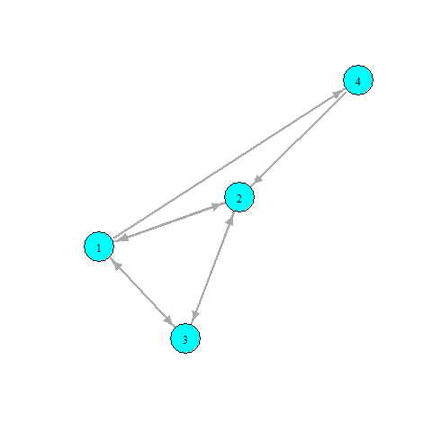
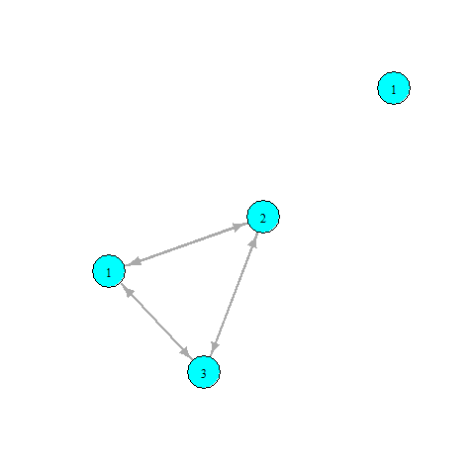
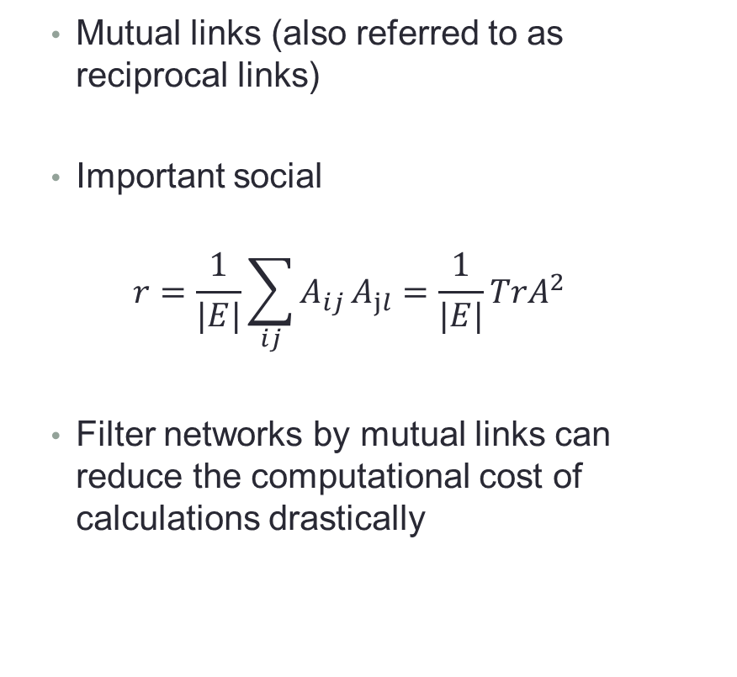
Basics of network theory
Mutual links (also referred to as reciprocal links)
Important social
$$r=\frac{1}{|E|}\sum_{ij}^{​}{A_{ij}}A_{jl}=\frac{1}{|E|}TrA^{2}$$
Filter networks by mutual links can reduce the computational cost of calculations drastically

Slide 14
A little break to play with R
Creating and plotting simple graphs in R
1_introduction.r

Slide 15
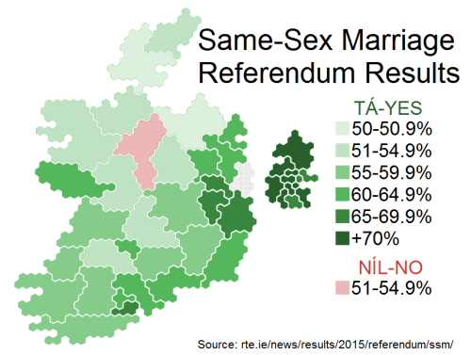
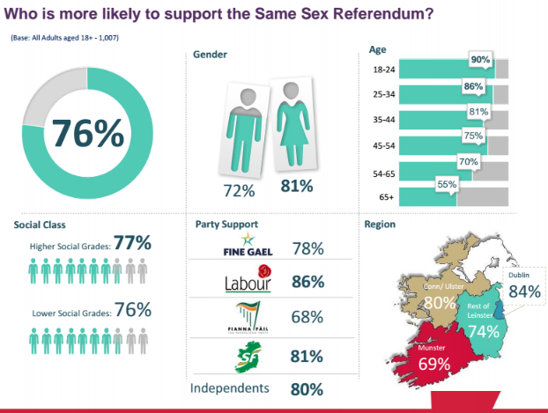
Irish Marriage Referendum Data
Irish Marriage referendum
22nd of May 2015
Passed by a 62% majority
High voter turn out 60%
I was interested in Twitter data
Collected an extensive dataset
“#marriageref” & “#marref”
7th and the 23rd of May
144,077 users & 499,642 tweets

Slide 16
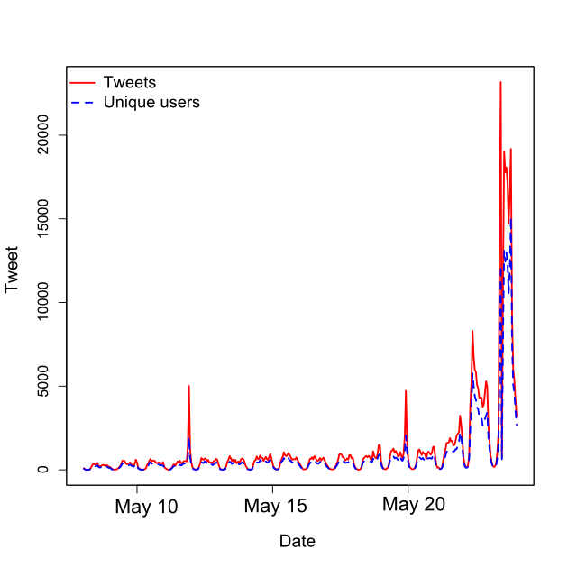

Irish Marriage Referendum Data
Each tweet contained
20 variables
Screen name
Time stamp
Text
Geolocation, etc
For each user
22 variables
Screen name
Description, etc
Friends list
177,669,550 directed links between users
First step?

Slide 17
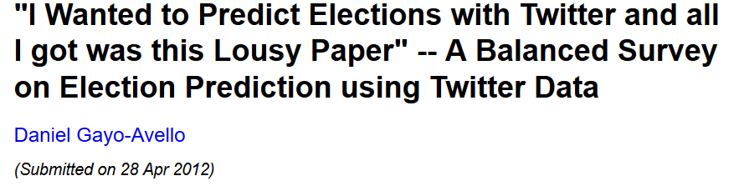
Irish Marriage Referendum Data
Just a work of warning
A lot of people have tried to predict stuff with twitter data…
Why?
Twitters API’s give a sample
And worse again probably not random sample
Demographically not representative
Geographically not representative
Activity rates between users differ... A lot!

Slide 18
Irish Marriage Referendum Data
But with those in mind…
Interested in sentiment on networks
How positive or negative content/users are
Does sentiment matter?
Sentiment sent and received?
Does sentiment cluster between users
Proxy for homophily?
Is it useful for classification of voters
Can we find yes and no voters?

Slide 19
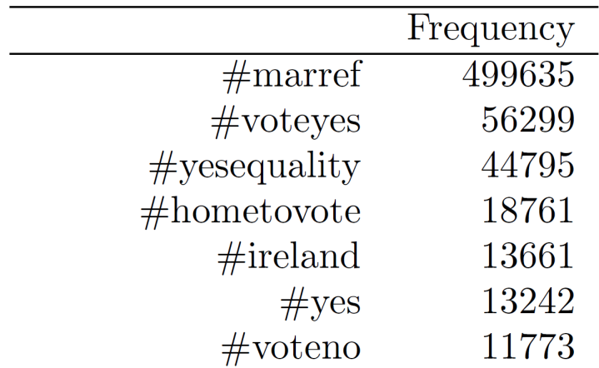
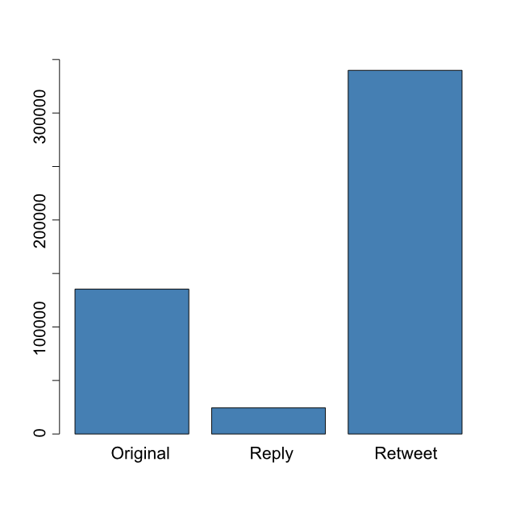



Data collection
#marref – very popular hashtag
#marriageref
not very popular (397)
Types of tweets
Of the 499,642
Original 135,370 (27%)
Reply 24,397 (5%)
Retweet 339,875 (86%)
Next step, homophily (sentiment)

Slide 20
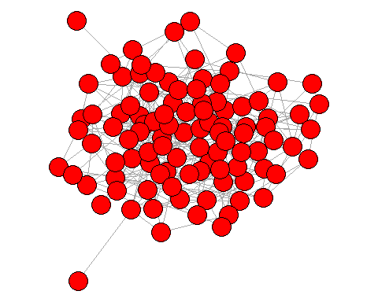
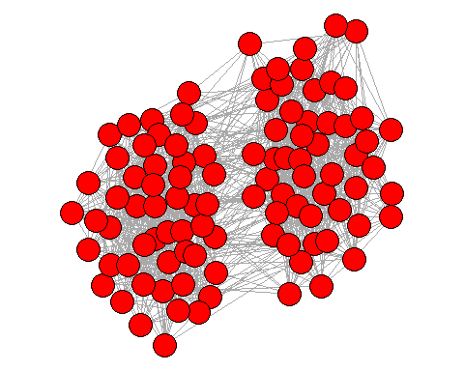
Homophily, what is it?
‘Birds of a feather flock together’
Do you see any homophily?
What drives homophily
For music preferences?
For sport team?

Slide 21
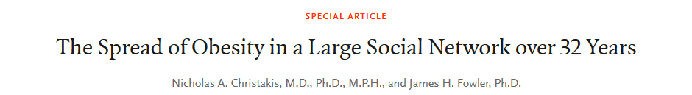
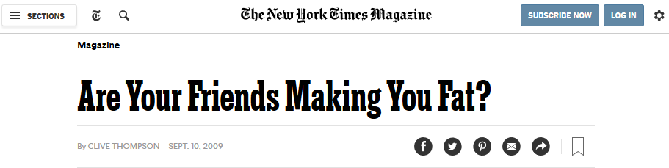
Homophily, what is it?
Very popular area in the social science
Very popular area in the social science
Leads to none articles like this….

Slide 22
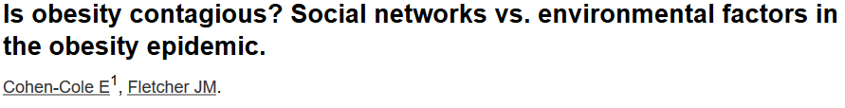
Homophily, what is it?
Tracked peoples BMI and social contact over time
How likely are we to be connected to other people with similar BMI?
Made casual claims that it ‘spreads’
Problem with confounders
Environmental factors
Geography
Age
Etc.

Slide 23

Homophily, what is it?
Correlation does not imply causation
Spurious correlations is a great website
Ideally, in this setting, how would you prove this is ‘contagious’? (what the gold standard)?

Slide 24
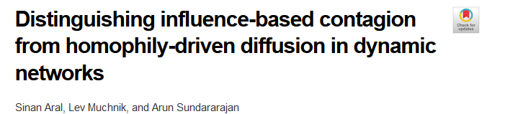
Homophily, what is it?
So, how can you differentiae between social and environment effects?
Partnered with Yahoo
30 million users Yahoo chat user
Over 6 months
Adoption of a new product
Extensive demographics information

Slide 25
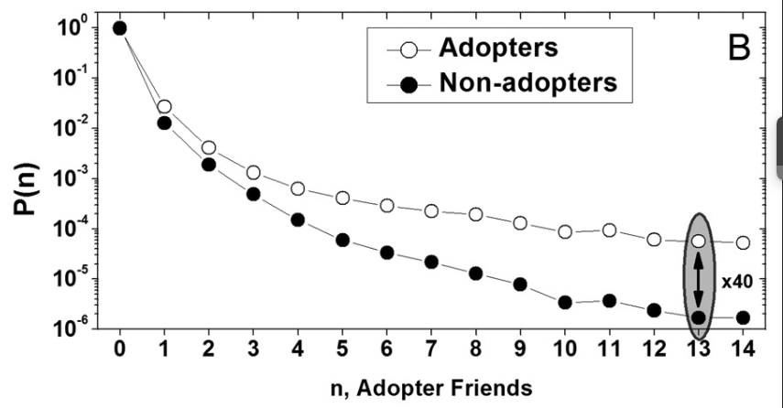
Homophily, what is it?
How likely are you to about adopt given adopter neighbours
Instead of using the raw network data
Dynamic match sample estimation

Slide 26
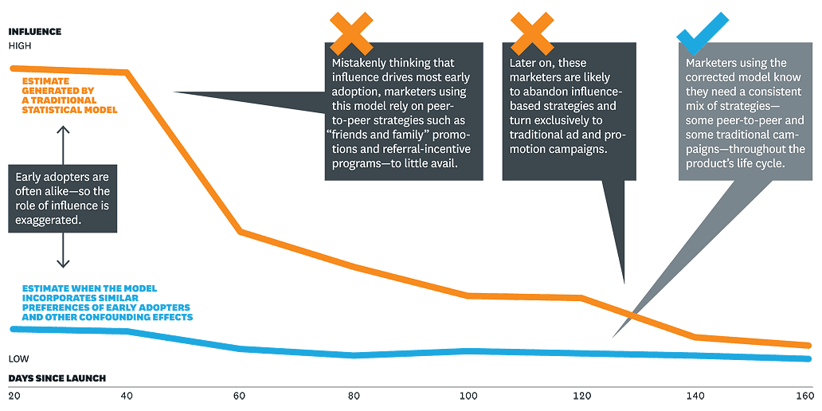
Homophily, what is it?
Self sorting of people connecting via there interests
Is this going to be a problem for us using sentiment?

Slide 27
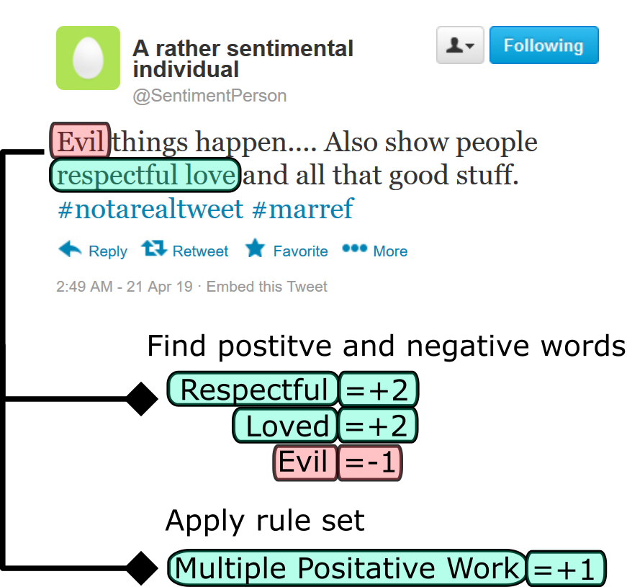
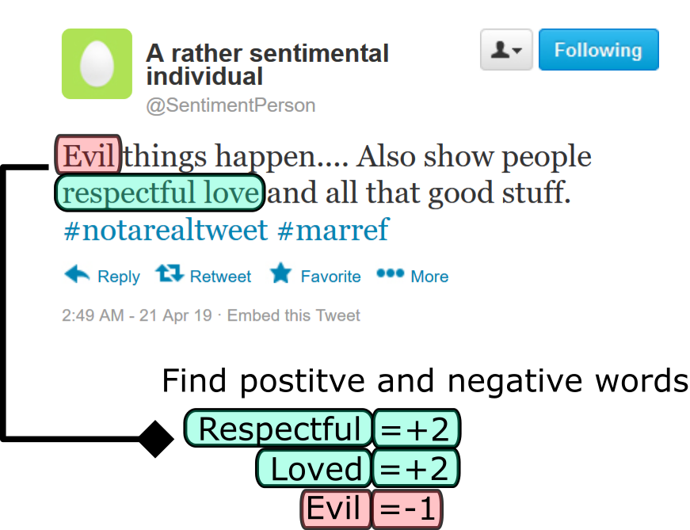
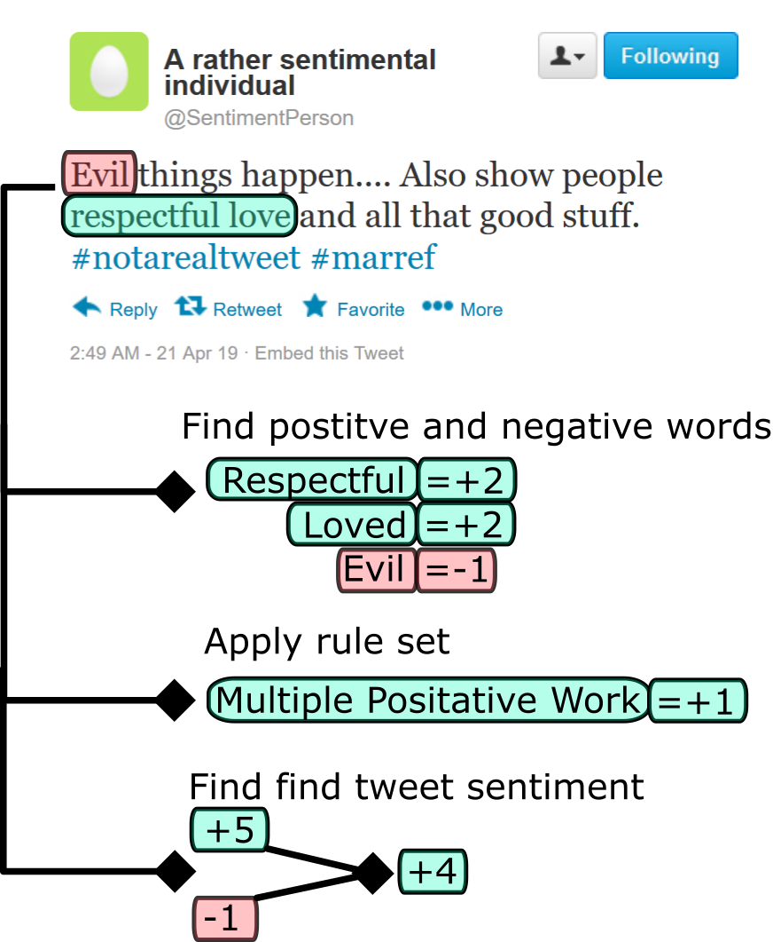
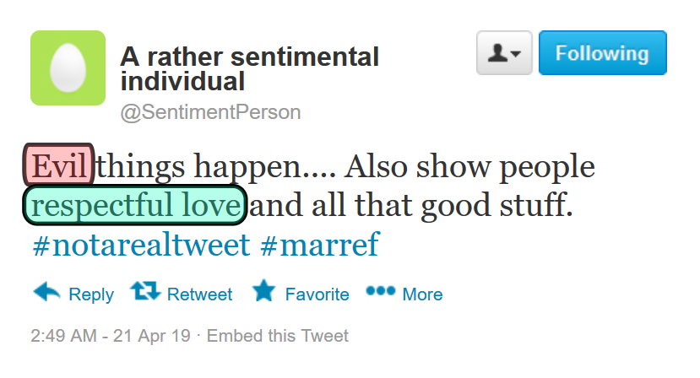
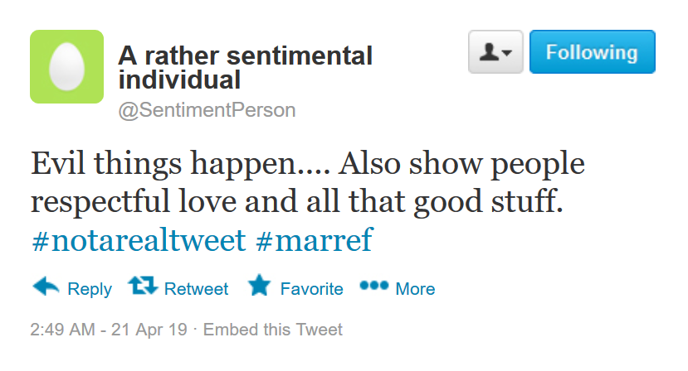
Tweet Sentiment
Find sentiment score for each tweet
How positive or negative the language is
SentiStrength¹
Calculating this for every tweet
Fine the positive and negative score
Take the difference to find a single sentiment score

Slide 28
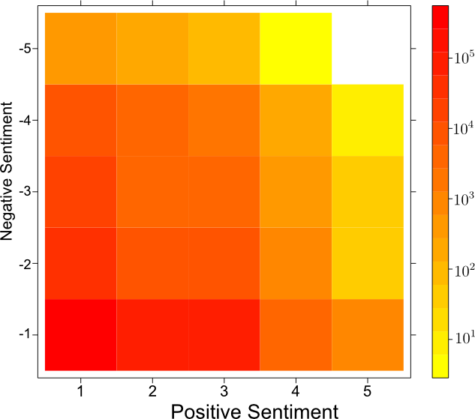
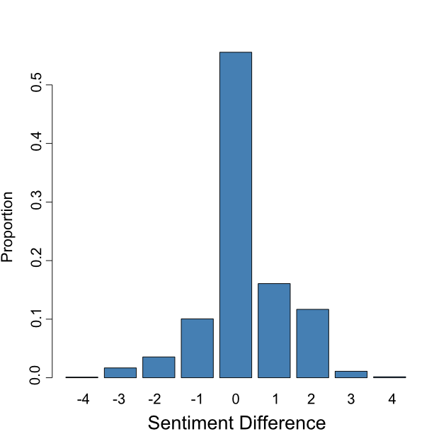
Tweet Sentiment
Distribution of scores
Scale from -4 to 4
Most tweets have 0 sentiment score (55%)
Vast majority had (-1,1) sentiment scores (95%)
Sentiment is noisy
Look to aggregate out the noise
Distribution of tweets per user
Average 4
Problematic for aggregation

Slide 29
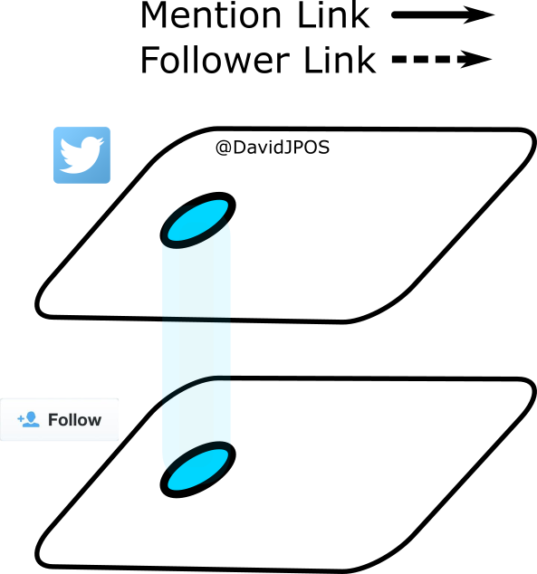
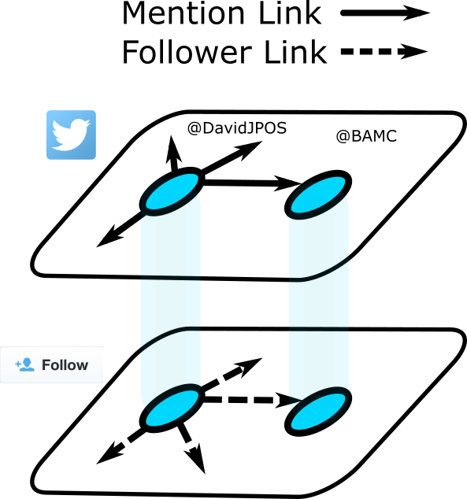
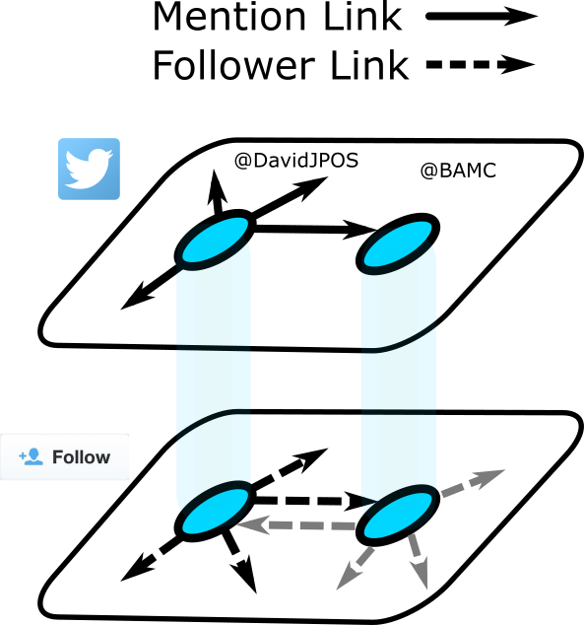
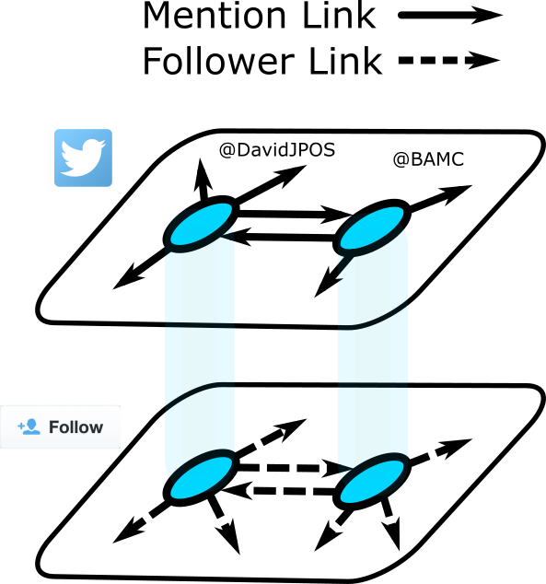

Network creation
Generate two networks
Mention – conversational
Follower – structural
Weight mention links by sentiment

Slide 30
Network creation

Slide 31
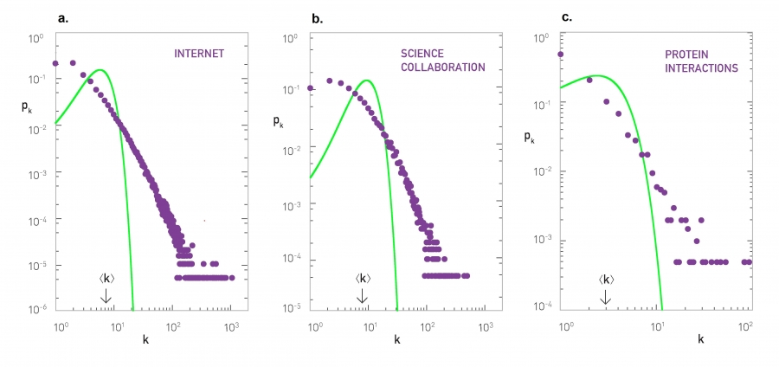
Network generation models
Erdos-Renyi model: G(N,p)

Slide 32
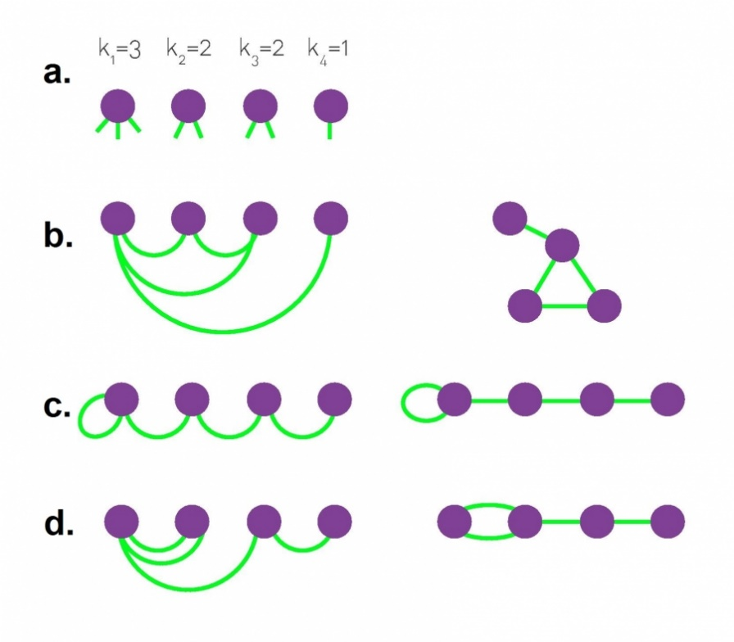
Network generation models
Configuration model
Defined degree sequence
Randomly connect ‘stubs’ together
Can contain
Multi edges
Self loops
But for large N these are small
Useful model analytically
But how close to empirical networks is it?

Slide 33
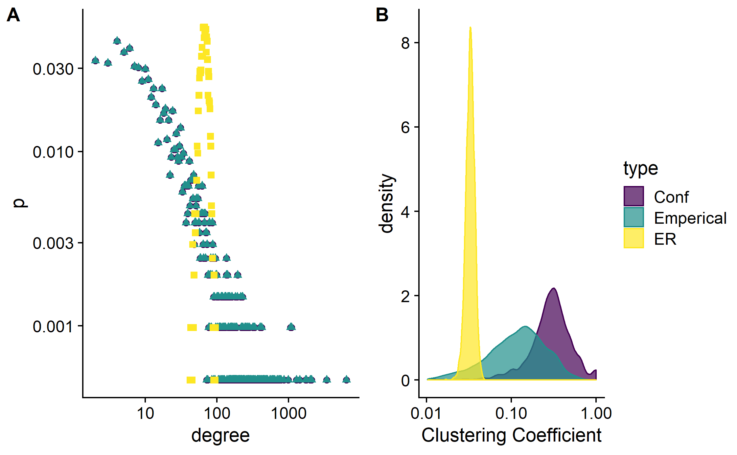
Network generation methods

Slide 34
Another little break to play with R
Network generation models
How would we generate similar networks to empirical observed networks?
Statistical networks
Ensembles properties of these random network
Convent to study
Erdos-Renyi model
Configuration model
2_descriptive.r

Slide 35
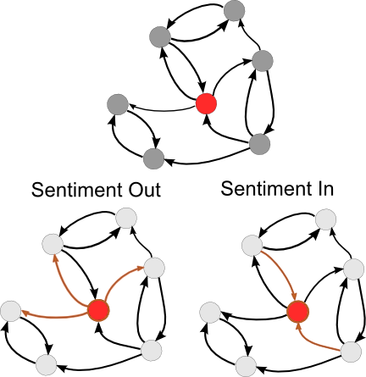
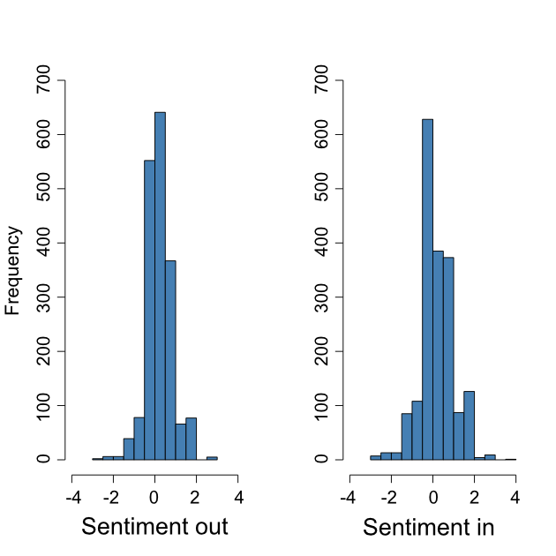
Tweet sentiment
Weight mentions network by sentiment
Calculate some nodal statistics
Average sentiment out
Average sentiment in
Correlation 0.59
How could these sentiment scores fail?
People may tweet out random nonsense
SentiStrength may be inaccurate
Given sentiment distribution & network topology
How likely are we to observe
Correlation
Connectivity between users

Slide 36
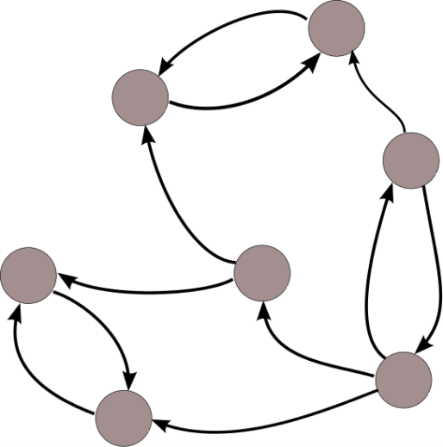
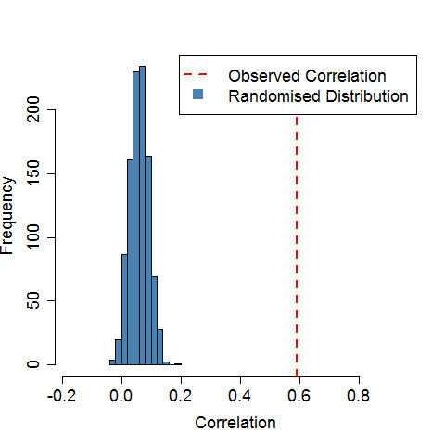
Randomisation tests
Correlation between sentiment in and out
Hold the network topology constant
Draw samples (with replacement)
Recalculate the correlation
Repeat M times
Compare randomised distribution to the observed correlation
What about the connectivity patterns?
(and not forgetting the follower network!)
s
s
s
s
s
s
s
s
s
s
s

Slide 37

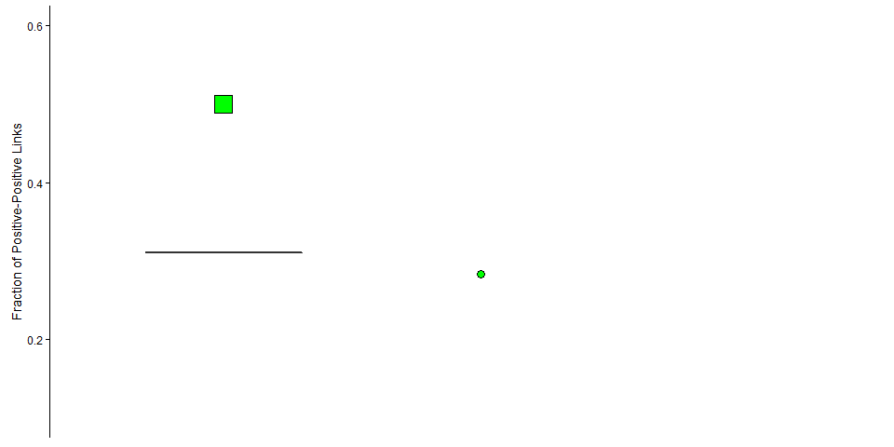
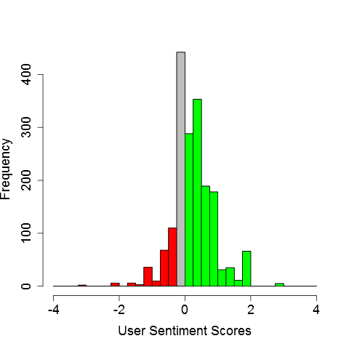


Sentiment & Homophily
Examine connectivity patterns
Observed fraction of
P-P links
23%
15%
62%
All connection types
Both networks
Simulated from
randomised network labels

Slide 38

Randomisation tests
Sentiment: correlation and clustering
Proxy for homophily, but still noisy…
Can we use this with groups of yes and no voters?

Slide 39
Again, another little break with R
So what did this analysis actually look like…
3_homophily_sentiment

Slide 40

Community detection
What is a community?
Types of communities?
Political networks?
Facebook?
Twitter?
How do we find them?
Hierarchical clustering
Modularity
Flow

Slide 41

Hierarchical clustering
Similarity based
Shared average cluster similarity

Slide 42
Hierarchical clustering
Current application
Fantasy sports

Slide 43
Hierarchical clustering
Slightly different network…

Slide 44
Hierarchical clustering
One type of node
Weighted
Temporal

Slide 45


Hierarchical clustering

Slide 46

Hierarchical clustering

Slide 47

Hierarchical clustering

Slide 48





Modularity, briefly
‘more density connected internally than externally’
Null model of a random graph to quantify quality of a community:
$$Q=\frac{1}{2m}\sum_{ij}^{​}{(}A_{ij}−\frac{k_{i}k_{j}}{2m})δ(c_{i},c_{j})$$
Optimizing this is NP-hard!

Slide 49

Modularity, briefly
Louvain Algorithm

Slide 50
Markov stability, again, briefly
Flow based methods

Slide 51
Again, another little break with R
So what did this analysis actually look like…
4_community_dectection.r

Slide 52


Community Detection
Markov stability on mentions and follower networks
Mentions
Partition into 2 communities
Follower
Partition into 6 communities
How could we combine information from both networks?
Like a unique partition that reflects both previous partitions
Refine both then cluster back together

Slide 53



Finding Yes & No Supporters

Slide 54
Community Detection
Markov stability on mentions and follower networks
Mentions
Partition into 2 communities
Follower
Partition into 6 communities
How could we combine information from both networks?
Like a unique partition that reflects both previous partitions
Refine both then cluster back together

Slide 55

Finding Yes & No Supporters
Use sentiment and community detection
What does makes up these three groups?

Slide 56



Community Detection and Sentiment
What about yes and no voters?
From each CC select random sample (20%) and classify
Hand classify as yes, no leaning or unaligned
How do we classify
Look at the tweets the user has sent
Profile description

Slide 57
Again, another little break with R
So what did this analysis actually look like…
5_community_aggregation.r

Slide 58

A little note on measuring performance
How do we measure our ability to find yes & no support?
Should really think about the best way to validate your model (a fair test)
Sometimes qualitative measures (fits) are good
Sometimes you a number, a quantitative measure
There is a lot to choose from!
Other options…

Slide 59

Finding Yes & No Supporters
Can do this in our case (or at least didn’t do this in our case)

Slide 60

Finding Yes & No Supporters
Can do this in our case (or at least didn’t do this in our case)

Slide 61


Finding Yes & No Supporters

Slide 62
Again, another little break with R
Back to the community detection with this one…
6_community_ detection_acc.R

Slide 63


Community Detection and Sentiment
What about yes and no voters?
From each CC select random sample (20%) and classify
Hand classify as yes, no leaning or unaligned
How do we classify
Look at the tweets the user has sent
Profile description
Redefine CC’s
Accuracy 89%
Balanced Accuracy 81%
How do these groups interact?

Slide 64
Activity between community clusters

Slide 65



Activity between community clusters

Slide 66

Activity between community clusters
Any thought?
How would you extend this work?

Slide 67
Cross Community Cascade diffusion
osullivan@maths.ox.ac.uk

